Slide 1
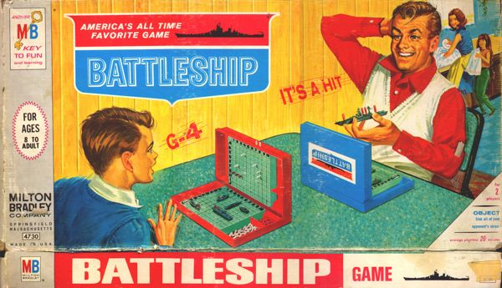
Battlesploosh
Awesome final project
based on the game Battleship
Kurt Andersen
kurt.t.andersen@gmail.com
Ryan Battistone
battistone@nevada.unr.edu
Frances Vinlove
f.vinlove@yahoo.com

Slide 2
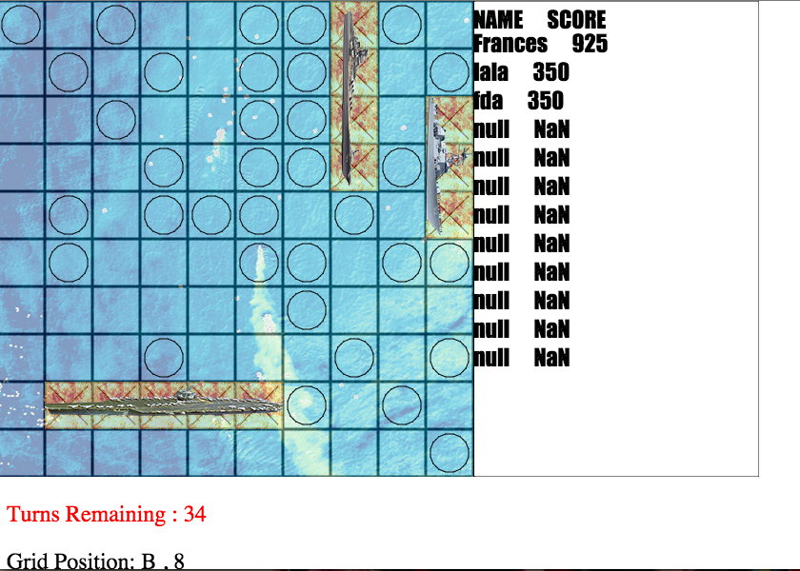
Overview:
Battlesploosh is based on the classic board game Battleship, first introduced in 1967.

Slide 3
Accomplishments:
Single player game
Top ten score list
Music and sound effects
soundsfancy.com
Satisfies:
2D array constraint, since the playing field is 2D
Honors, since the game is on the web

Slide 4
What was fun: What was not:
Understanding how to code it
Playing the game and showing it to my friends
Getting the game board set up
Getting the scoreboard to work properly
Getting the random number generator to function properly

Slide 5
Acknowledgements:
All the group members for their hard work
Dave & Sushil for their mouse-position function
Feedback from friends suggesting a name change for the game
Milton Bradley for creating the game, The Legend Of Zelda: The Wind Waker for the sound effects, and John Williams for the “Cantina Band” song

Slide 6
Run Demo!

